Slide 1
Task manager
Presenter:Edwin metto
Date of presentation:14 October 2024

Slide 2
introduction
My project is a task management system that is capable of adding ,editing , deleting, showing the priority of the task if its either of low or high importance and marking the completed task.
This project addresses the need that one will no more struggle remembering which task is completed and which is not completed.
TASK MANAGER SYSTEM HAS COME UP TO HELP THOSE PEOPLE WHO MIGHT BE WORKING IN DIFFERENT FIELDS AND HAS GOT A LOT OF TASK AND BY USE OF THIS SYSTEM THEY WILL MANAGE THEIR TASKS WELL

Slide 3
TASK MANAGER OVERVIEW
High level overview of this system is that it can add some subtask to the main task.
The main features of task management system is that it adds the task , edits, delete, adds subtask and marks completed task.
This application adds value because it avoids the use of pen and paper hence keeping data safe.

Slide 4
Target audience
Targeted audience for this application are those who are employed in different fields such as institutions and companies and have got different tasks to manage.
The system has add button and the subtask button and also checkbox to show whether the task is completed.
It enables addition of task and the subtask and also when the task is completed.

Slide 5
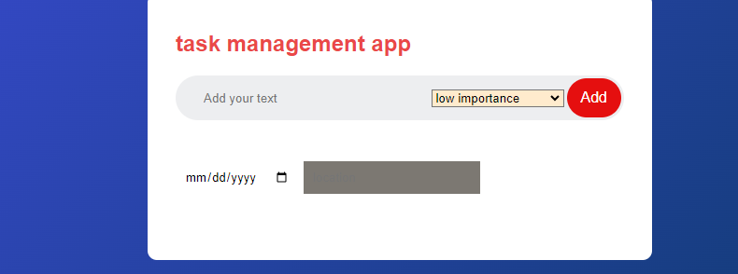
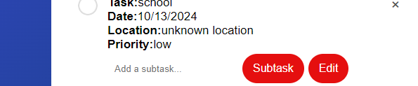
User interface and user experience
User interface : this is the page that directs one on how the system works
User interface : this show the edit button and subtask button and the the deleting span

